Slide 1

CONSCIOUS UNCOUPLING
Innovative ways to separate user habits from user needs

Slide 2

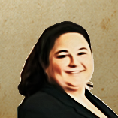
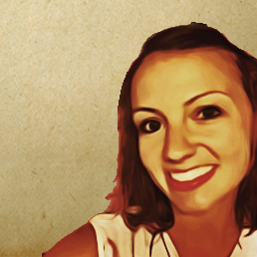
INTRODUCTIONS
KRISTEN LOHMAN
UX designer
NATALIE KURZ
JESSICA MARINE
UX designer
Product owner

Slide 3
TABLE OF CONTENTS
01
UNITED STATES TAX COURT (USTC)
Building a new case management system
02
HOW HABITS BECOME DOGMA
Avoiding the “That’s the way we’ve always done it” trap
03
BARRIERS TO CHANGE
What we have here is a failure to communicate
04
HOW TO OVERCOME
Tactics for change

Slide 4

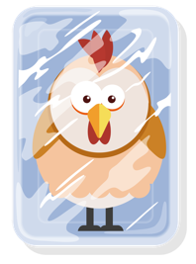
Example 1: An analogy for UX research
REQUIREMENT
What’s the best way to thaw frozen chicken?

Slide 5


Example 1: An analogy for UX research continued
REALLY…
What’s the best way to thaw frozen chicken…without the cat eating it?

Slide 6
UNITES STATES TAX COURT (USTC)
01
Building a new case management system

Slide 7
HISTORY
The United States Tax Court is the primary federal court that resolves issues between taxpayers and the IRS.
30-35 JUDGES
35+ YEARS
Who work at the Tax Court in Washington D.C.
Age of Court’s current legacy case management system
73 CITIES
11.5 YEARS
Judges travel nationwide to provide access to the Court for all
Average length of service for 166 current Court employees
70%
2017
Taxpayers who represent themselves, so everything has to be very user-friendly
Put out competitive procurement to build new open-source system

Slide 8
SYSTEM OVERVIEW
Build a green field case management system to receive, track, and manage petitions to the United States Tax Court contesting federal taxes.
COMMUNICATION
TRIALS
Send messages, add notes to cases, receive notifications
Schedule trials across different cities, assign cases to trials, track status
CASE MANAGEMENT
REPORTING
Work case through its entire lifecycle
Standard reports run frequently, on-demand and customized reporting
DOC MANAGEMENT
ROLE-BASED ACCESS
Scan paper, edit data, print docs, e-sign, maintain versions, etc.
Permission-based views generated by user roles, sealed cases
CREATE DOCUMENTS
AUTOMATION
Write, edit, and issue orders, share access to certain docs, save draft
Digitize and automate manual or paper processes

Slide 9
CHALLENGES
In addition to the usual challenges of building complex software, we faced other unique obstacles.
COULDN’T SEE SYSTEM
DISCONNECTED APPS
Strict NDA meant vendor couldn’t see a single piece of the existing system — no screens, no data
New features were rolled out as a separate system/app that didn’t talk to the existing ones
SYSTEM OWNERSHIP
COMPLEX WORKFLOWS
Many employees helped in the creation of the existing system over years of use
The system has over a dozen user types with different permissions, needs, and tasks
LONG-TIME USERS
OFFLINE PROCESSES
Many users have been on the system for 20+ years and aren’t very tech savvy
Cases were only initiated with a paper petition and many complicated processes were offline

Slide 10
HOW HABITS BECOME DOGMA
02
Avoiding the “that’s how we’ve always done it” trap

Slide 11
WORKAROUNDS & TRADITIONS
PROMPTED BY SYSTEM LIMITATIONS
01
Misunderstood user needs, long turnaround times, and technical constraints made workarounds necessary
WORKAROUNDS
DRIVEN BY INSTITUTIONAL KNOWLEDGE SILOS
Solve the immediate problem without removing the obstacle
02
As long as it gets done, the challenges are not shared across the organization
CONTINUES THROUGH TRAINING
03
Antiquated processes are passed down to new employees who don’t understand their origin

Slide 12
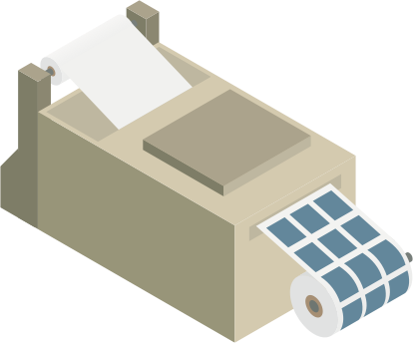
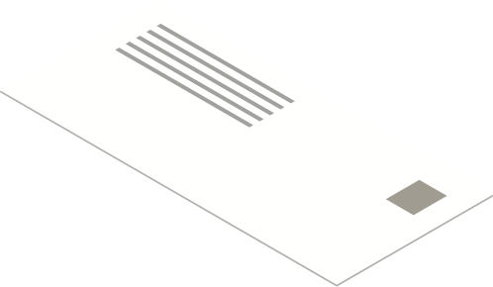
Example 1: printing addresses
REQUIREMENT
System needs to integrate with label makers

Slide 13

Example 1: printing addresses continued
REALLY…
Able to mail documents to petitioners

Slide 14


Example 2: assigning case numbers
REQUIREMENT
Assign online petitions case numbers based on pre-numbered folders

Slide 15

Example 2: assigning case numbers continued
REALLY…
Assign sequential case #s from both online and paper petitions

Slide 16
OUR JOB AS RESEARCHERS
Uncover the REAL problem and see where we can remove artificial constraints

Slide 17
BARRIERS TO CHANGE AT USTC
03
What we have here is a failure to communicate

Slide 18
JARGON
Language originating from antiquated process

Slide 19
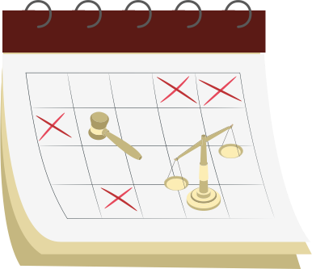
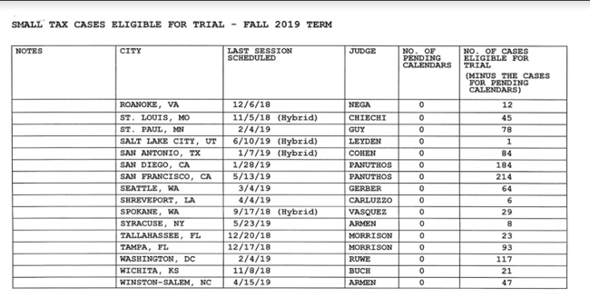
EXAMPLE – WHAT’S A CALENDAR?
To Court users, Calendar was a process where they’d print out dozens of reports and manually determine where to have trial sessions based on complex criteria.
US
COURT USERS

Slide 20
SILOS
Reluctant to share all they know

Slide 21
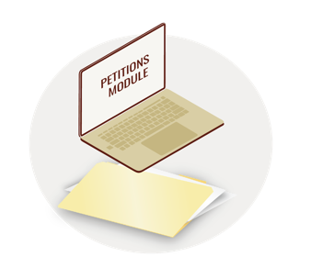

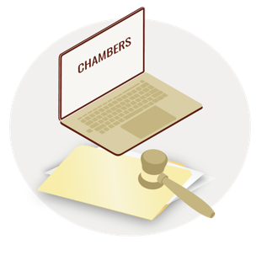
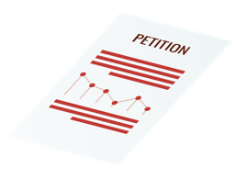

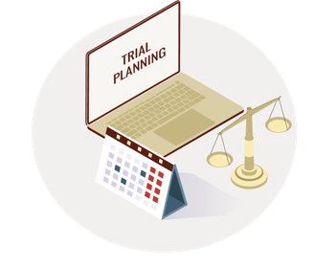
EXAMPLE - CASE LIFECYCLE PROCESS
Employees were experts at their jobs and super users of the legacy system – but very few people could give you a comprehensive view of the entire process.

Slide 22
FEAR OF CHANGE
Job security; ownership of processes

Slide 23
EXAMPLE – RESISTING CHANGE
Our attempts to automate a process failed because Court employees were so used to the existing workaround, they didn’t think it needed improvement.
What are your digits?

Slide 24
RULES & REGULATIONS
It’s the law

Slide 25
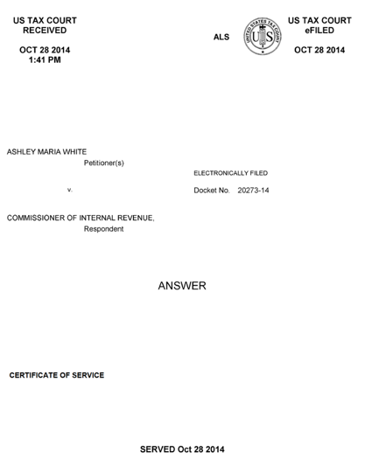
EXAMPLE – CAN’T IMPROVE DESIGN
The Court had to generate a cover sheet for incoming documents that displayed a lot of specific data – in a less than optimized way.
ORIGINAL
REDESIGNED

Slide 26
HOW TO OVERCOME
04
Tactics for change

Slide 27
LISTEN!
Let them do the talking; gain clarity on goals and tasks

Slide 28
HOW TO LISTEN
The Court users had all the information we needed to build an effective system. All we needed to do was listen.
BUILD TRUST
PROBE WITHOUT JUDGEMENT
01
Create a safe environment for users to open up
04
Listen without commentary or feedback as you learn
LEARN THE HISTORY
ALLOW FOR SELF-DISCOVERY
02
Understand the circumstances that led to current processes
05
Give people space to have their own epiphanies
REPEAT FOR CLARITY
03
Communicate in your own words to verify understanding

Slide 29
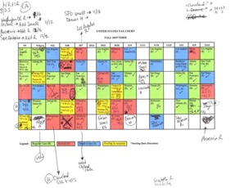
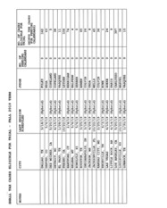
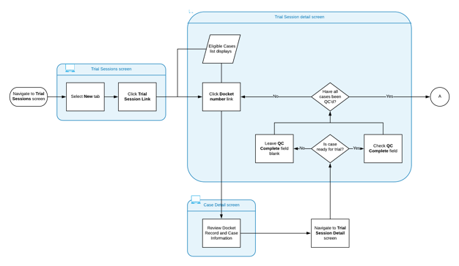
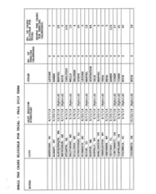
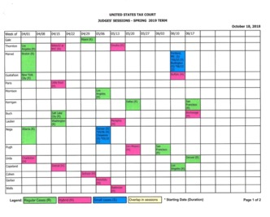
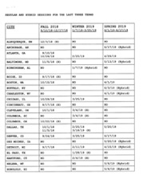
EXAMPLE – CALENDAR PROCESS
Understanding the “calendaring” process was one of the biggest challenges of this project.
LISTEN, GATHER, OBSERVE
VISUALIZE THE PROCESS

Slide 30
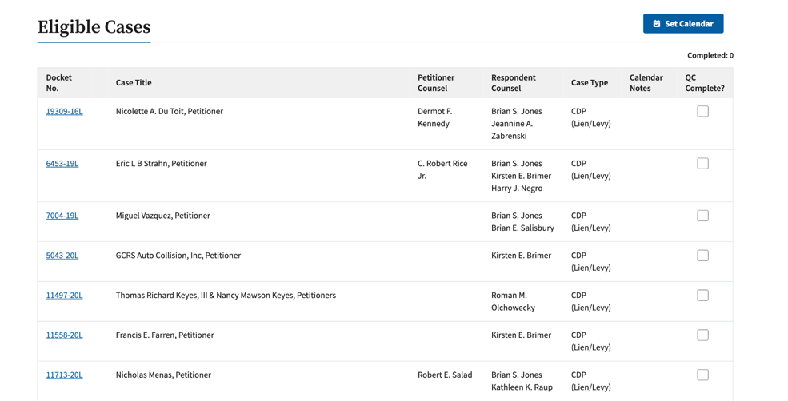
EXAMPLE – OUTCOME OF LISTENING
Through listening tactics, we were able to take a stack of reports and a process that took over two weeks to complete…and replace it with a button!
BECAME THIS

Slide 31
WIN USERS OVER
Build trust, gain buy-in

Slide 32
HOW TO WIN USERS OVER
You need users to feel comfortable enough to be honest with you and have them trust that you’re working in their best interests.
BE A SKEPTIC, TOO
BUILD EXCITEMENT
01
Embrace the user’s skepticism about a new system
04
Let users see the incremental improvements
EXPLAIN THE “WHY”
ENCOURAGE OWNERSHIP
02
Walk users how UX works and why we’re asking these questions
05
Help them see how their needs and ideas are incorporated into the new design
SHARE, SHARE, SHARE
03
Involve users early and often in design feedback sessions

Slide 33
EXAMPLE – USER FEEDBACK
During collaboration and usability testing sessions, we repeatedly heard encouraging comments from users about the new system.
"I like the idea of having messages on my dashboard. Yeah, that works for me."
- Judge
"Once I hit that one button it's a done deal? That's cool!”
- Calendar Clerk
“With everything in one place it makes job functions a lot easier.”
- Docket Clerk

Slide 34
UNCOVER HIDDEN NEEDS
Keep probing until you get to the root causes

Slide 35
HOW TO UNCOVER HIDDEN NEEDS
You need users to feel comfortable enough to be honest with you and have them trust that you’re working in their best interests.
FIVE WHYS
GET CREATIVE
01
Keep asking “why” until you get to root causes
04
Think outside the box from how users currently work
MIXED RESEARCH METHODS
PUSH THE BOUNDARIES
02
Usability testing, 1:1 deep dives, and group discussions helped reveal the full picture
05
Don’t let existing constraints go unchallenged
REFRAME THE QUESTION
03
Users can speak more to what they need to do than how they want to do it

Slide 36
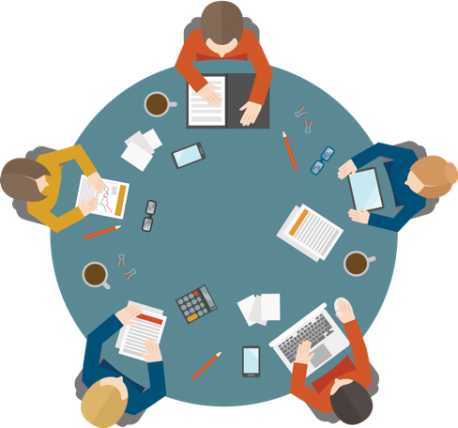
EXAMPLE – ROUNDTABLE USABILITY TESTING
We conducted end-to-end testing using a cooperative approach with all user groups where they could experience one another’s tasks, challenges, and needs.
PUT THINGS IN CONTEXT
Create scenarios as close to real life as possible
GAIN A HOLISTIC VIEW
The system wasn’t just siloed tasks — rather an end-to-end flow that involved many handoffs between processes

Slide 37
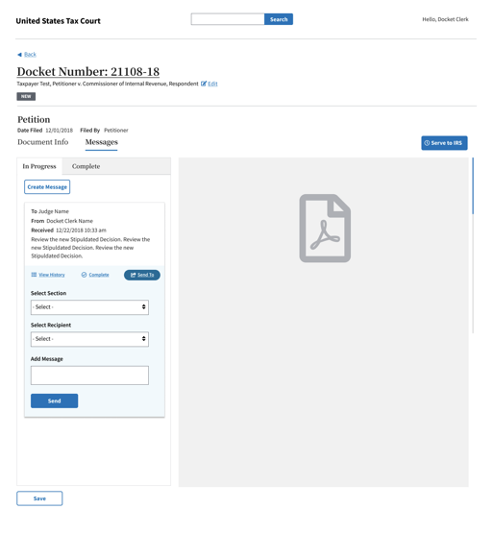
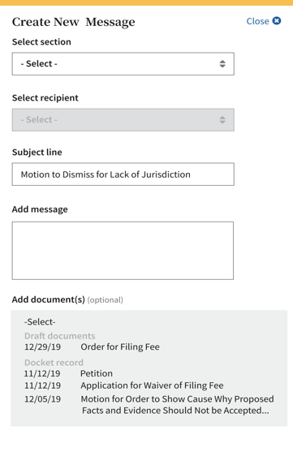
EXAMPLE – MESSAGEING & DOCUMENTS
Users kept talking about sending documents to each other — what they really needed was to send messages with or without documents attached.
WHAT THEY SAID THEY NEED
WHAT THEY REALLY NEED

Slide 38

The end result
RESULT
Perfectly thawed chicken!

Slide 39

THANK YOU
Q&A

